Slide 1
Bases teóricas y practicas para la administración de servidores
Víctor Manuel Martínez Martínez
vicm3@upn.mx

Slide 2
Unix
Unix (trademarked as UNIX) is a family of multitasking, multiuser computer operating systems that derive from the original AT&TUnix, developed in the 1970s at the Bell Labs research center by Ken Thompson, Dennis Ritchie, and others.
Wikipedia
Filosofía hacer una cosa y hacerla bien

Slide 3
¿Por qué Linux?
Y no UNIX
Patentes
En los 90, GNU… Hurd
ATT vs Berkeley
Al final un pequeño clon de Minix que no será Minix (Torvalds, Tanenbaum)
Disponible

Slide 4
Dos grandes
Red Hat –Fedora, abierto, innovador, soporte por la comunidad
RHES (con costo), soporte a largo plazo
CentOS
Oracle Linux
Scientific Linux
Debian – Abierto, soporte por la comunidad
Ubuntu
Canaima
Collax
Damn Small Linux
Finnix
Knoppix

Slide 5
Ciclos de soporte, Red Hat
Red Hat offers subscription services for each major release of Red Hat Enterprise Linux throughout four life-cycle phases—called Production 1, 2, and 3, and an Extended Life Phase.
Red Hat Enterprise Linux versions 5, 6, and 7 each deliver 10 years of support in Production Phases 1, 2, and 3 followed by an Extended Life Phase. In addition, for Red Hat Enterprise Linux 5, customers may purchase annual Add-on subscriptions called Extended Life-cycle Support (ELS) that provide similar support to Production Phase 3 through November 30, 2020.
Red Hat Enterprise Linux 4 is offered with seven years of Production Phase support followed by an Extended Life Phase. In addition, customers may purchase annual Add-on subscriptions called Extended Life Cycle Support (ELS) that provide similar support to Production Phase 3 through March 31, 2017. https://access.redhat.com/support/policy/updates/errata/

Slide 6
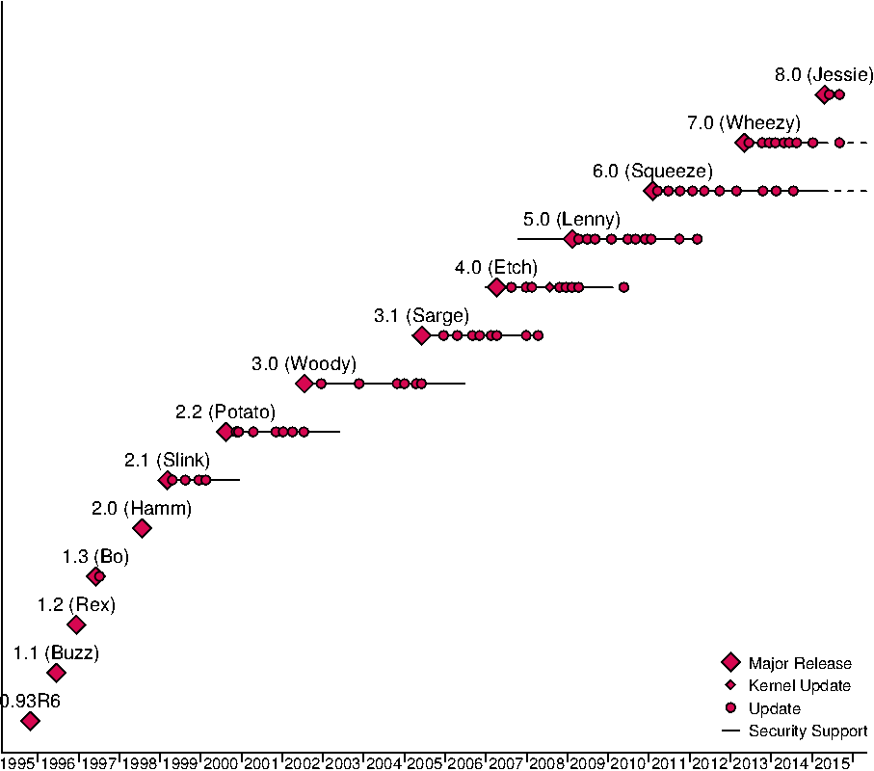
Ciclos de soporte Debian

Slide 7
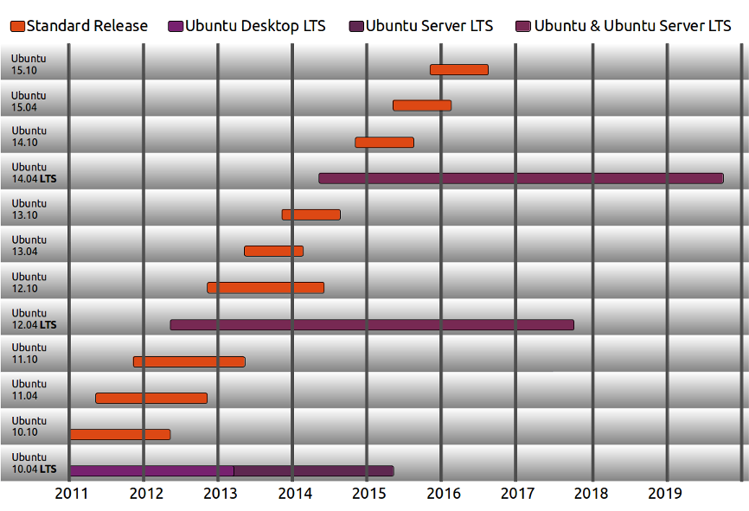
Ciclos de Ubuntu

Slide 8
Porque uno y no otro
Red Hat
Debian
Ubuntu
Oracle Linux
Escriba aquí su favorito…

Slide 9
Servidores Hardware

Slide 10
Servidores Software

Slide 11
¿Preguntas, comentarios?
Víctor Martínez
vicm3@upn.mx

